Slide 1
WELCOME Good practice event and stakeholder meeting Utrecht 30-31 March 2022

Slide 2
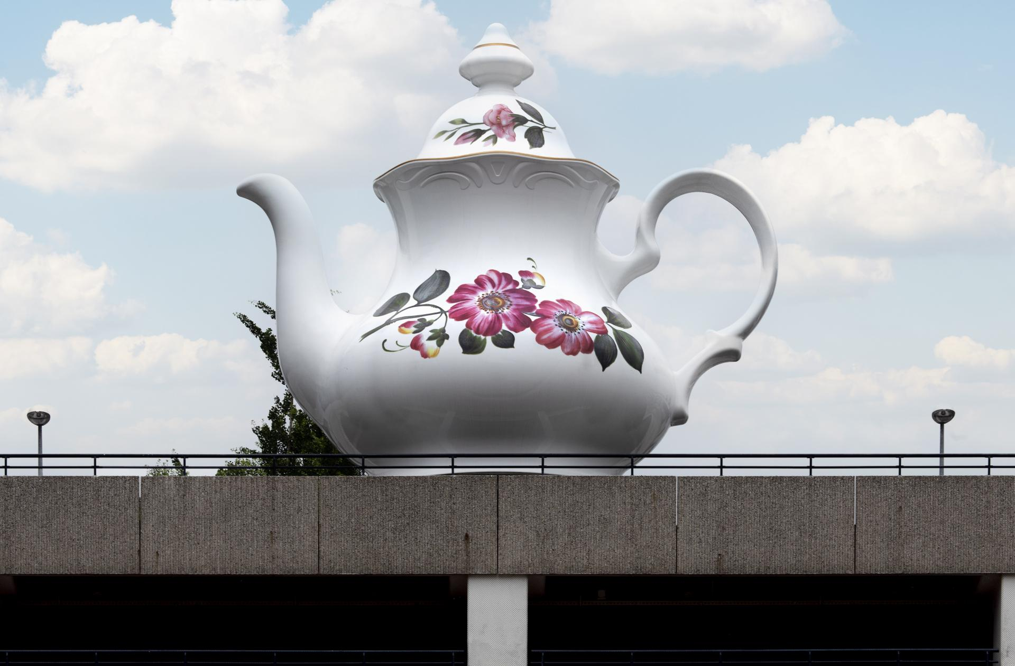
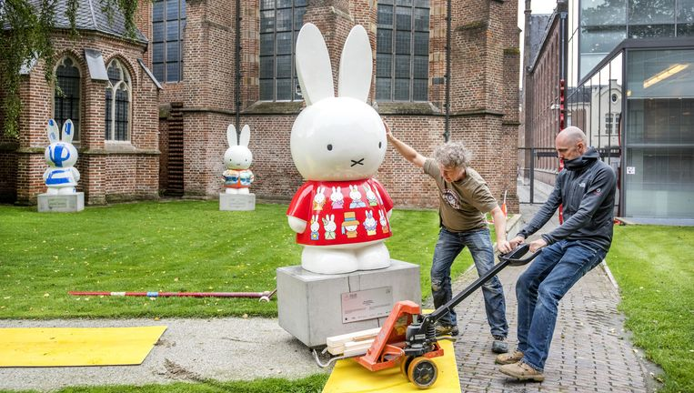
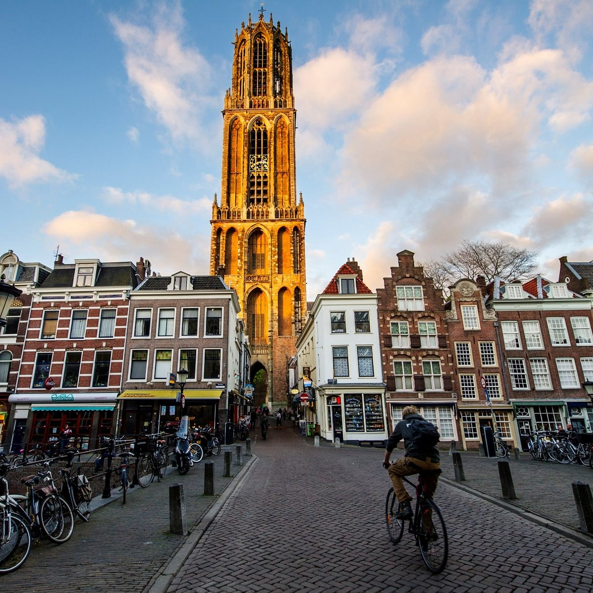
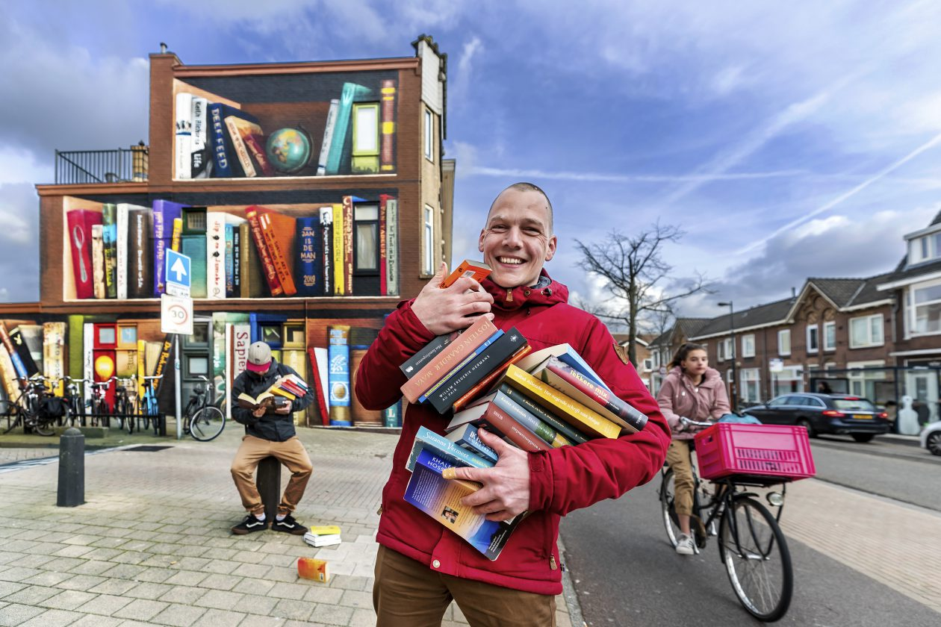
Goodmorning Utrecht!

Slide 3
Programme today
9:00 | 9:05 | Welcome and introduction to the programme
9:05 | 10:00 | E-bus deployment in Gozo – Status Quo, Drivers and Barriers (Good Practice sharing Gozo) Joseph Piscopo (EcoGozo Directorate) Kimberlin Bartolo (Malta Public Transport)
10:00 | 10:30 | Structured approach to e-bus transition – Online (Good Practice sharing Hamburg) Nina Zeun (VHH)
10:30 | 11:00 | Break
11:00 | 11:30 | Driver and staff training in e-bus deployment (Good Practice sharing Turku) Rami Wahlsten (TUAS)
11:30 | 12:00 | Driverless Electric Shuttle – Online (Good Practice sharing Italy) Roberto Cavaliere (Merano Municipality)
12:00 | 12:30 | The procurement and operation of the e-bus fleet in Pécs (Good Practice sharing Pécs/ Paks) Zoltán Haász (STRIA)
12:30 | 13:30 | Lunch break

Slide 4
Programme today
13.30 | 14:00 | Transfer to the municipality buildings “Stadskantoor
14:00 | 15:00 | Presentation on the nearby new station-area: the largest railway station in the Netherlands, the world’s biggest cycle –parking, the heart of the national public transport system, and good practice for sustainable urban area development
15:00 | 15:15 | Transfer back to the Driehoek
15:15 | 16:30 | Action Plan workshop
16:30 | 16:45 | Closure

Slide 5
Presentations
After a presentation you will be asked a number of questions. As a reply; would you hold up one of the three colored post-its (cards)?
Questions:
- Are you going to adopt the Good practice? Green
- Are you going to partly adopt the Good Practice? Yellow
- Can't you adopt the Good Practice? Pink
I will ask you then for a short explanation

Slide 6
Action Plan workshop
We will start all together, with a short explanation about the method of this workshop:
There are several billbords in the room with posters from the regions on it. They highlight the activities for the Action Plan per region
Next to each poster stands at least one representative from the region. With him/ her you can discuss on the actions/ Action Plan
This representative will summarize at the end of the workshop all the comments collected and give a reflection
So please, walk around, maximum group size per billboard is 7 people
We will end all together and listen to the representatives

Slide 7
The end Good practise event and stakeholder meeting Utrecht 30-31 March 2022

