Slide 1
Improving urban mobility through self-driving vehicle
Roberto Cavaliere
Tech Transfer Digital, NOI Techpark Südtirol / Alto Adige
r.cavaliere@noi.bz.it
30-31 March, 2022 – Good Practice Event, Utrecht

Slide 2
Table of Contents
The framework: the Interreg «MENTOR» project
Presentation of the good practice
Recommendations and next steps

Slide 3
The framework: the Interreg «MENTOR» project

Slide 4
The Interreg «MENTOR» project
Project duration: 29.11.2018 – 28.11.2021
Project budget: 1.164,75 € + 320.000 CHF
Merano (I), ~ 40k inhabitants
Goals
Pilot sharing mobility services that are by design complementary with public transportation
First local tests of comprehensive MaaS applications
Brig-Glis (CH), ~ 13k inhabitants

Slide 5
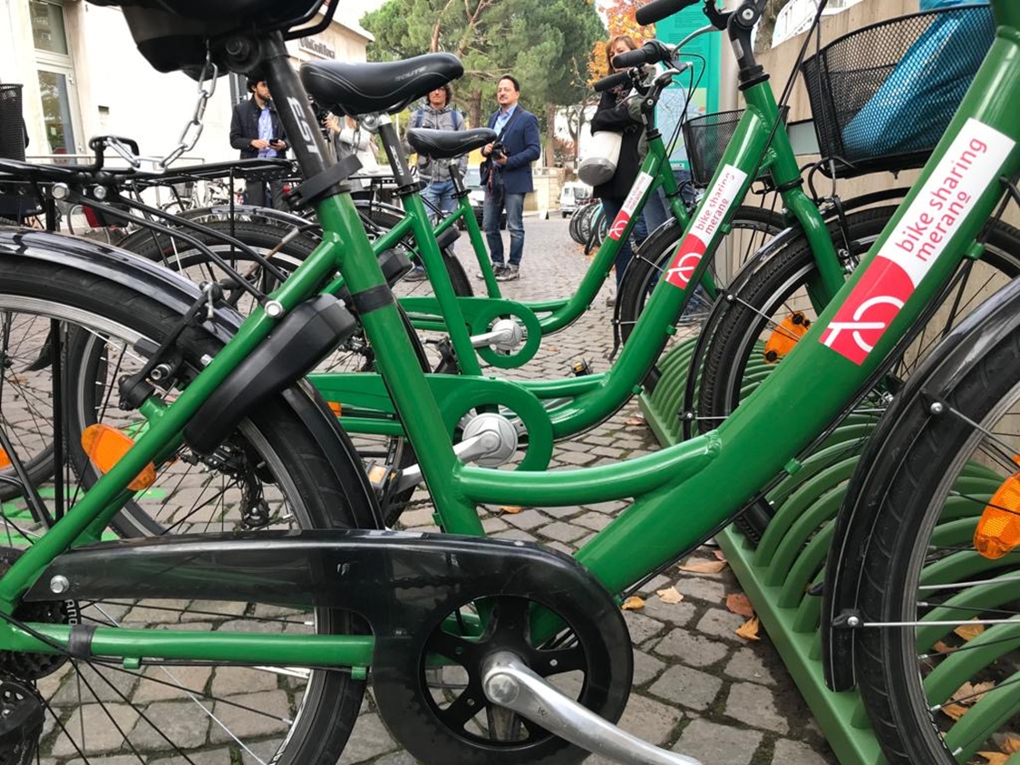
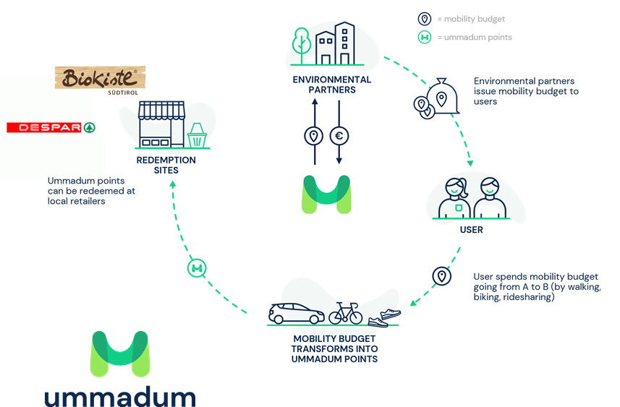
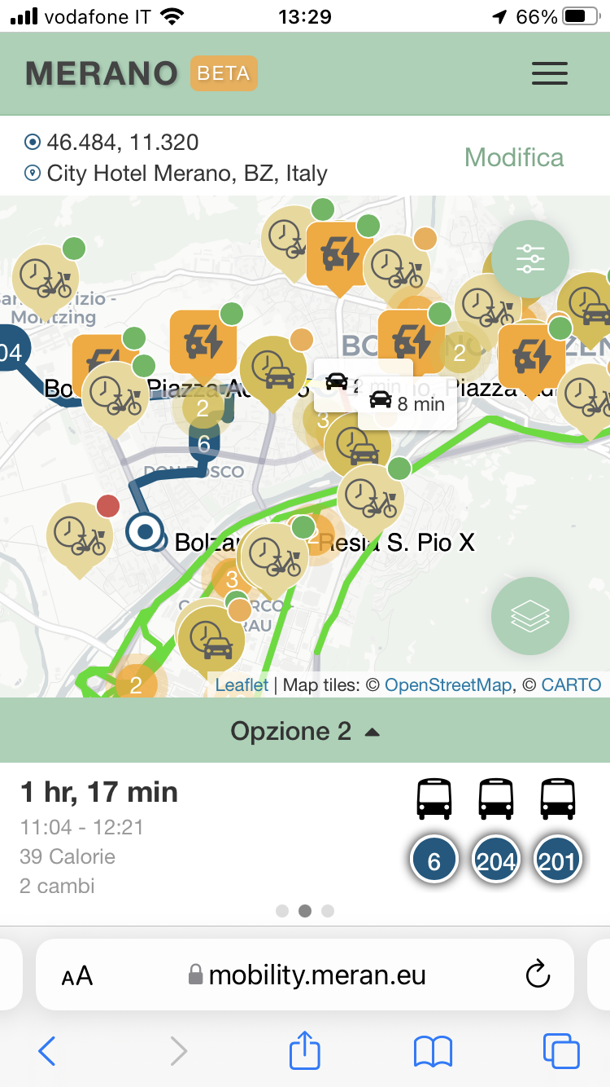
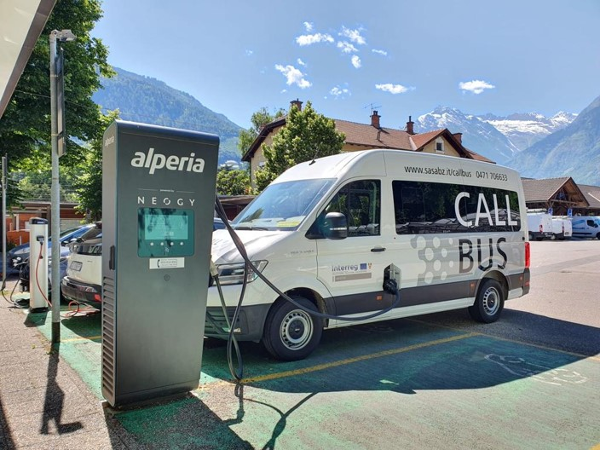

Slide 6
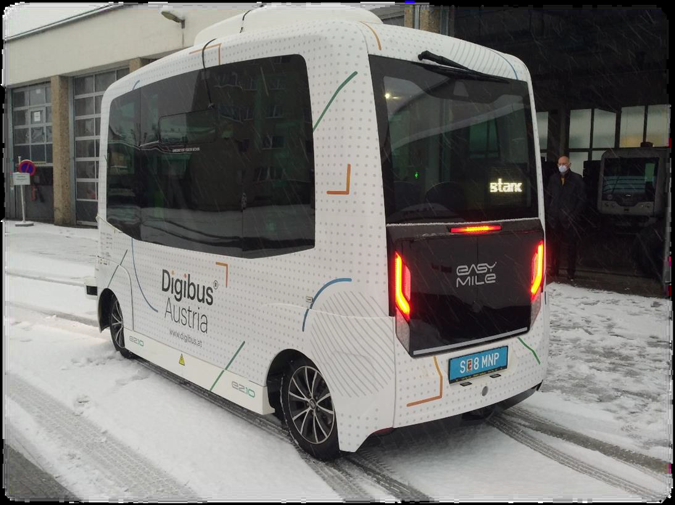
Autonomous shuttle services: where are we?
Electric autonomous (SAE-4) shuttles, first / last mile services
Several pilot demonstrations on-going to advance the technological state-of-art, increase user acceptance and find viable business models
Current technological challenges: increase of ODD, complex use cases (V2X), on-demand functionality, remote control
Source: Digibus project

Slide 7
Presentation of the good practice

Slide 8
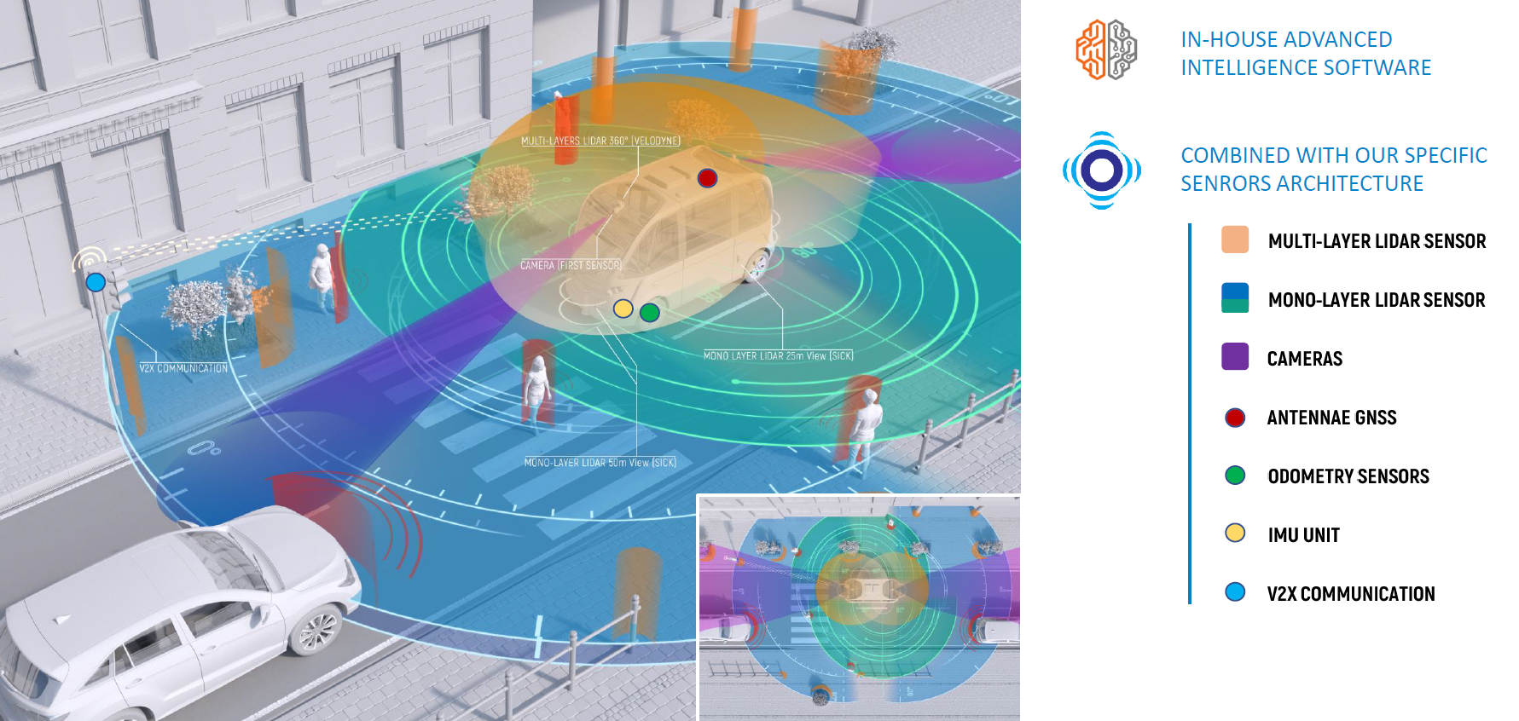
Objectives of the pilot
Check the maturity of the technology for «basic» first/last mile services in an alpine environment
Demonstrate a possible «on-demand» public transportation service of the future
Evaluate the acceptance level of local users of autonomous vehicle technologies / services
Supplier chosen for the demonstration:
Navya (FRA)
i-Mobility Garage (ITA)
Source: Navya

Slide 9
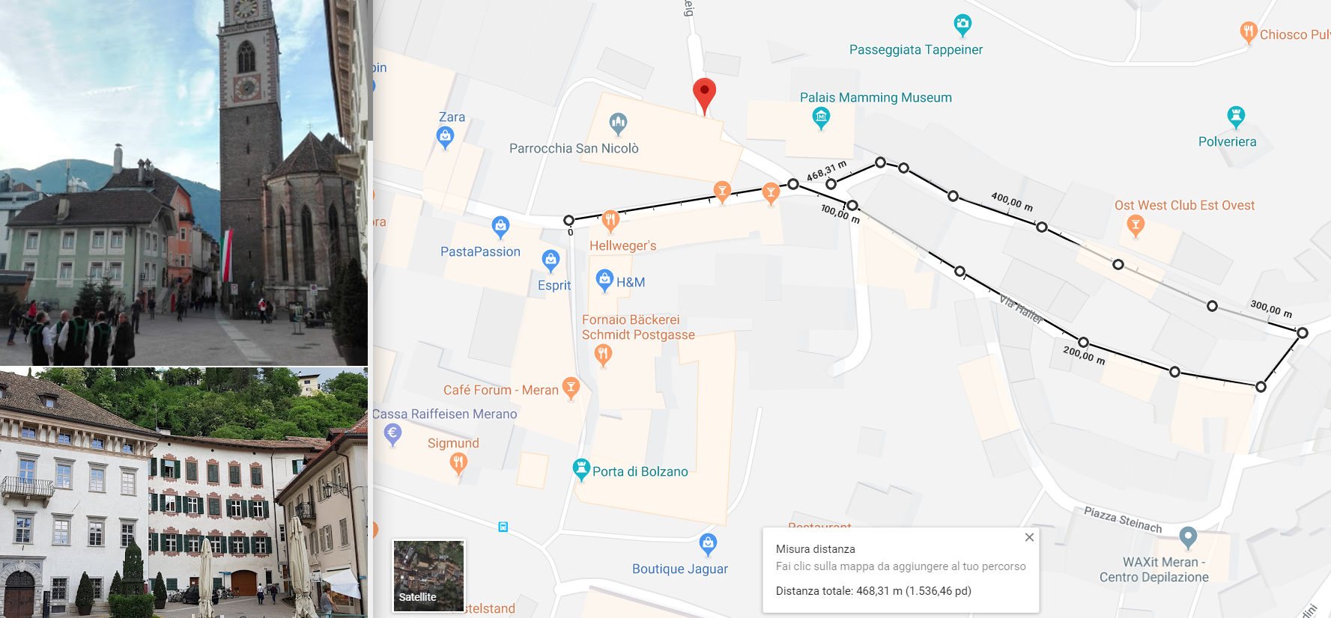
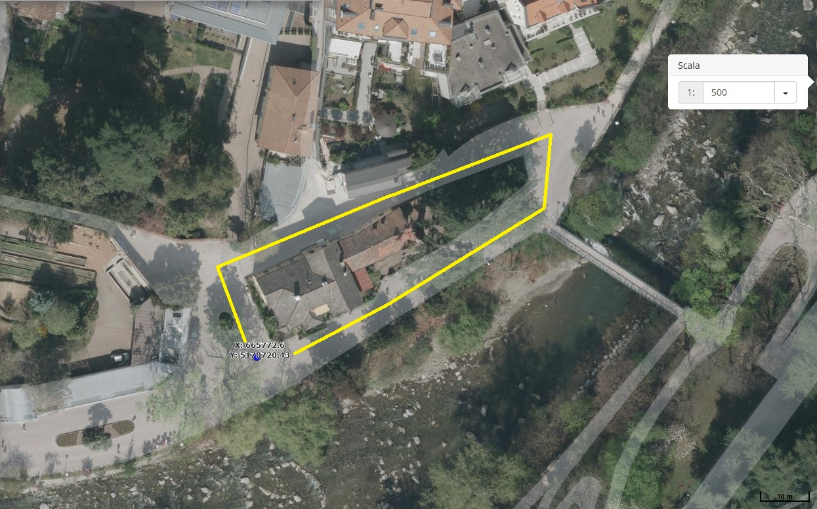
Route choice
At the time of the pilot, no legislative support at national level. The pilot execution (the first of this kind in Italy) helped to solve this gap
Initial idea: longer test route, in mixed traffic
Final choice: much smaller route, street closed for the demonstration

Slide 10
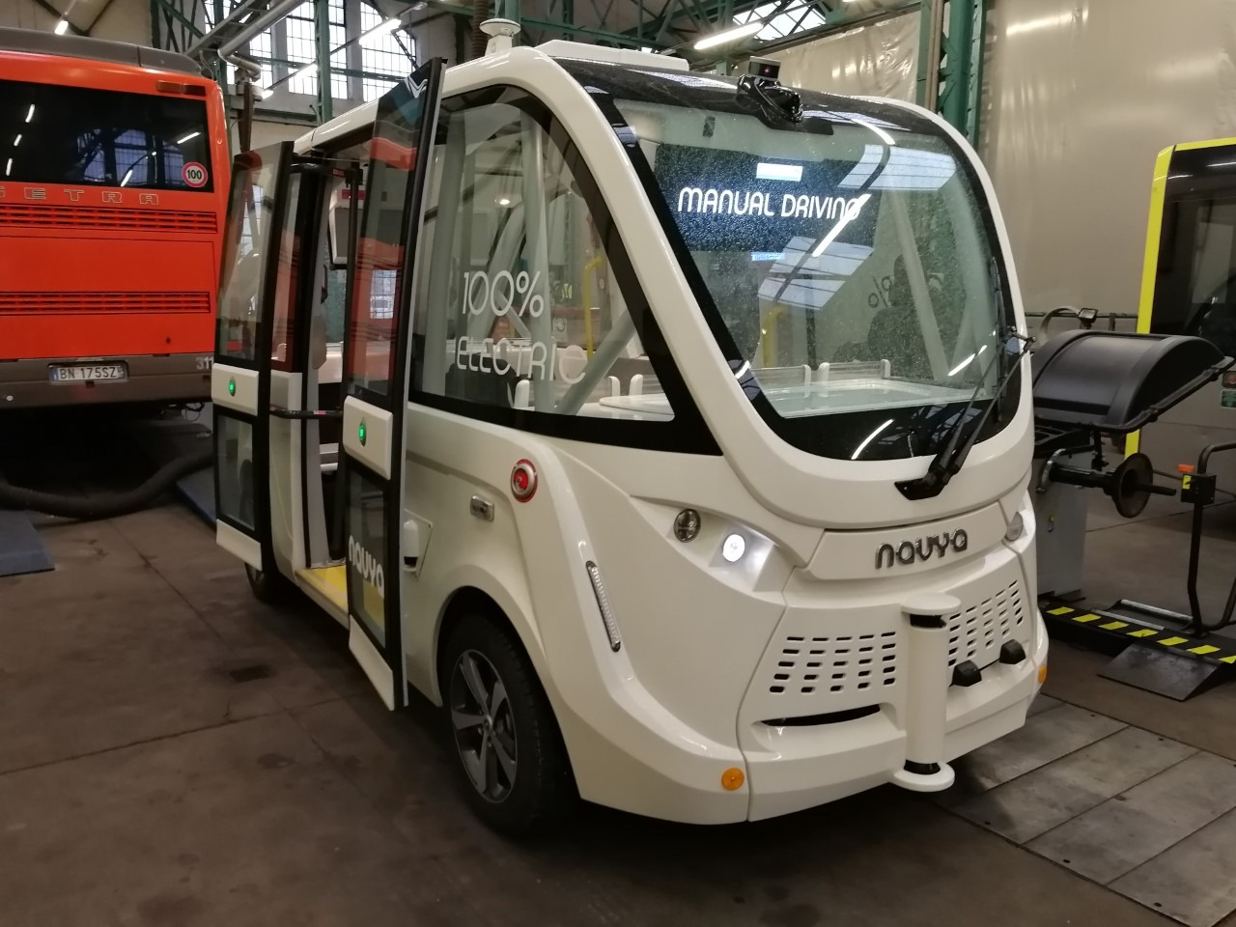
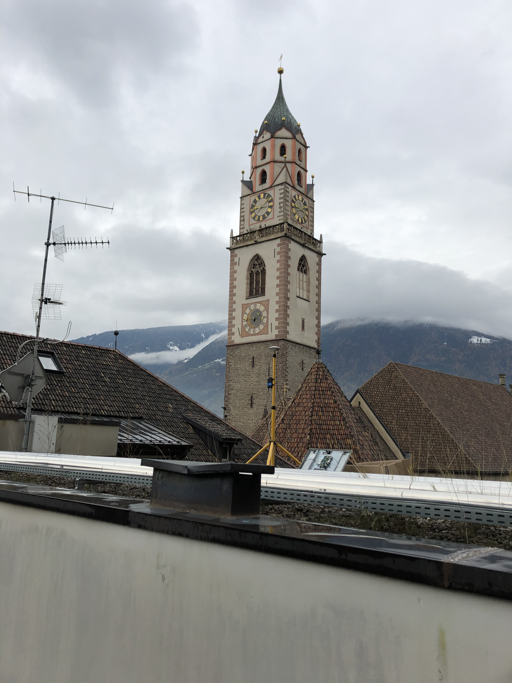
Additional organizational aspects
Vehicle charging and secure parking: at a depot of a local PTO (charging at night). To be highlighted: transport of shuttle through a tow truck before and after the daily service execution!
Route mapping: in order to ensure the proper functioning, the vehicle needs to “study” the route in advance. This is carried out through a high-resolution location system → need of installation of a GNSS antenna on a nearby roof to ensure spatial accuracy in the order of [cm].
Very difficult to complete these operations due to many onlookers on the circuit (including journalists)!

Slide 11
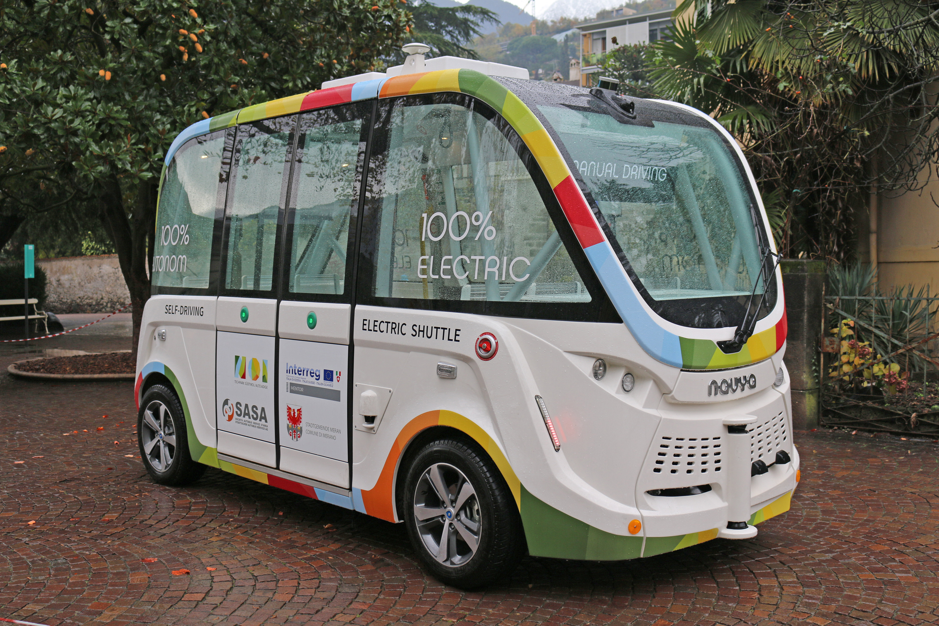
Pilot demonstration (KPIs)

Slide 12
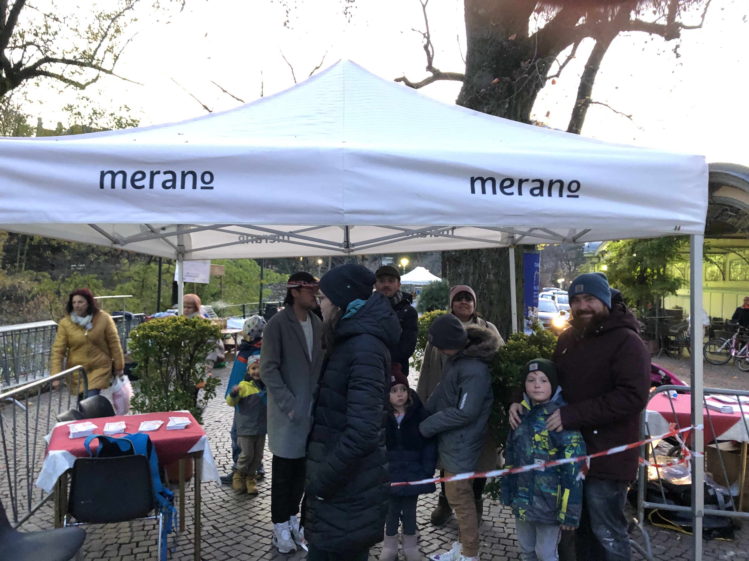
Pilot demonstration (acceptance)
Interviews carried out before and after the test of the service
543 passengers (24.5% of the total passengers) + 220 “observing” people
Main target group represented: > 50 years old (37%)
Low trust level before the test: 45.1%
Low trust level after the test: 5.1%
The pilot demonstration was fundamental to increase the trust towards the technology and new future mobility services, in particular by elderly people

Slide 13
Recommendations and next steps

Slide 14
Lessons-learnt and recommendations for replication
Autonomous shuttles are nearly ready to be used for very specific and limited commercial mobility services. The more challenging aspects are of financial and organisational nature. Additional pilots are needed in order to manage more complex services in challenging operating conditions
Once you plan a similar pilot, you should consider to:
clearly define and communicate the objectives of your trial, and ensure to have the right resources to implement it. Our pilot had a cost of about 40 k€;
vehicle charging is typically not an issue (could be carried at night), but ensure to have a secure depot near the test route – a cooperation with a PTO here is ideal;
if necessary, activate and resolve all legislative clarifications in good time.
be careful not to hinder vehicle preparation activities due to excessive communication!

Slide 15
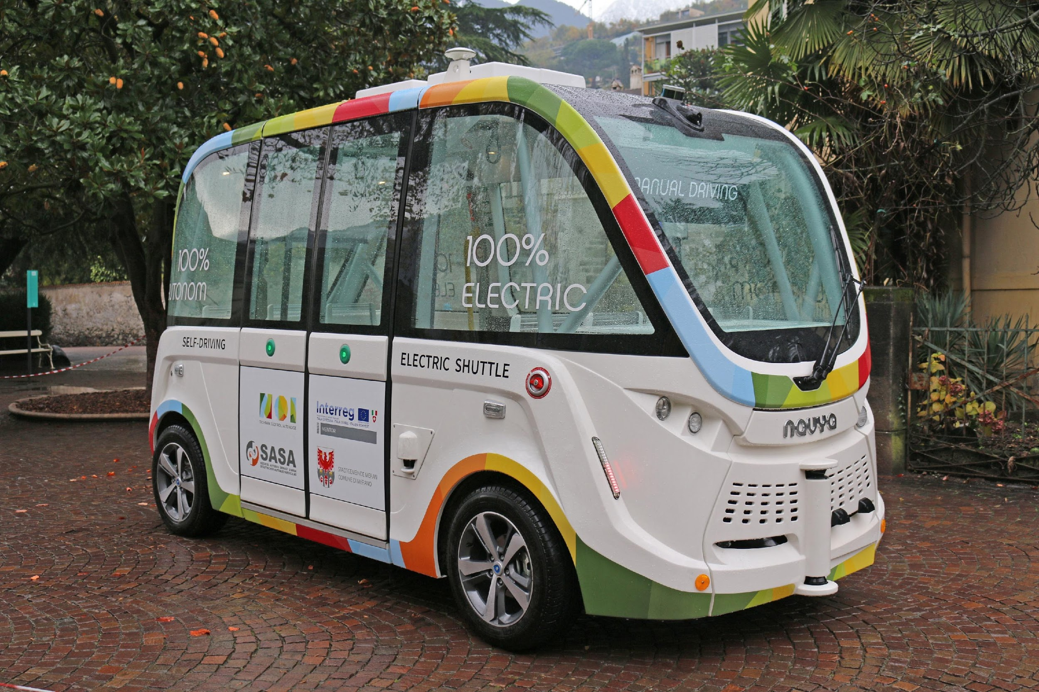
Our next pilot project
NOI Techpark
Test track + area
Bolzano South Train Station / Bolzano Fair

Slide 16
Thank you!
Questions welcome

