Slide 1
Mobility electrification in the Pécs Public Transport

Slide 2
Tüke Busz Plc.
Start of operation: 1 April 2012
Owner: Municipality of Pécs City of County Rank, 100%
Number of employees: 470 people

Slide 3
City of Pécs and the location of Tüke Busz Plc. premises within the city (headquarter, bus stations, maintenance unit)

Slide 4
Current bus fleet
Manufacturer and type | Verison | Number of buses
Mercedes-Benz O345G Connecto | Articulated | 24
Volvo 7700A | Articulated | 38
Volvo 7900 A | Articulated | 5
Credo Citadell 12 | Solo | 20
Credo Econell City | Solo | 5
Volvo 7700 | Solo | 72
BYD K9UB | Solo | 10
Total number of buses |  | 174

Slide 5
Main traffic data
Number of bus lines: 91 (+ 8 night lines)
Number of bus services per working day: 2,284
Useful kilometres per working day: 23,549 kms
Number of passengers transported (2019): 40,103.1 thousand people/year
Rate of bus services successfully completed (2019): 99,81%
7 million kilometres driven per year

Slide 6
Line network

Slide 7
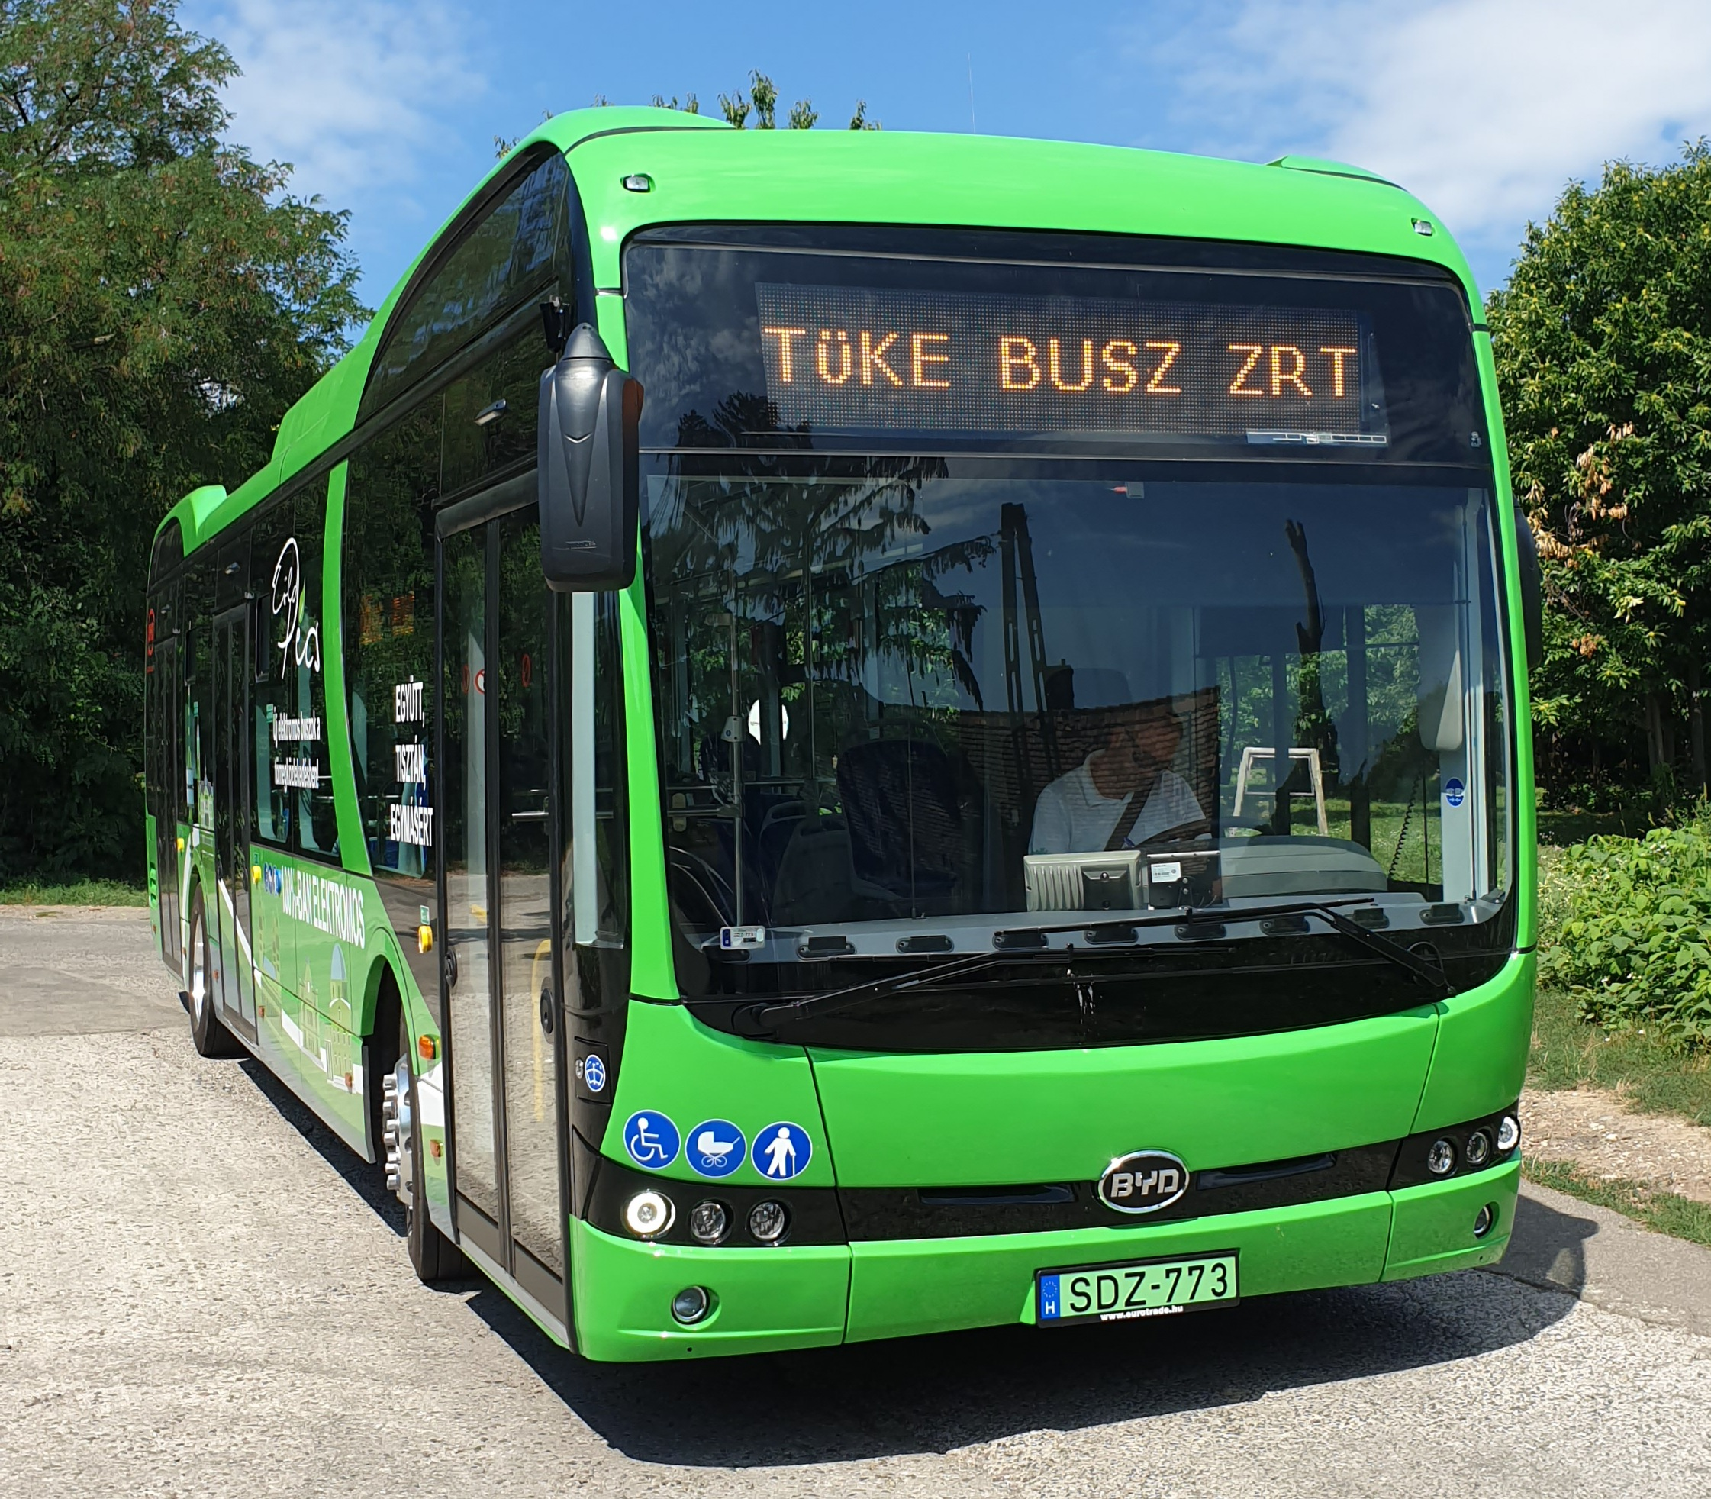
The electric bus fleet as of today
10 db BYD K9UB buses
„Floading” AC chargers
Solo buses
Procurement financed from ITDOP
Planned running 75,000 kms/bus/year
Average energy consumption
1,06 kWh/km

Slide 8
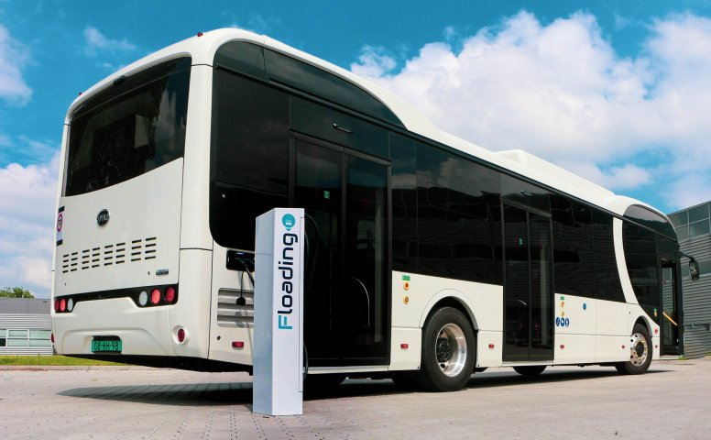
Charging infrastructure
„Floading” chargers
10 pcs of 2x44kw AC charger,
2 pcs Type 2 charger with connectror
Charging time: 4-5 hours

Slide 9
Difficulties in operation
BYD buses
Construction error of the air conditioners in the passenger compartment. Repair of the problem took 1,5 months.
Door adjustments, lack of professional support from the manufacturer
Passenger compartment hand-grips, USB chargers get lose, and turn to different directions
Motor vehicle body parts are delivered during 5-6 weeks

Slide 10
Difficulties in operation
Charging infrastructure
Unacceptable sercive support
Service support headquarters is in the Netherlands, without Hungarian service support
Slow reaction time to the problems
Slow management of guarantee issues
As a consequence, the e-buses are quite often out of service

Slide 11
Against all of these we go forward…
Within the Green Bus Programme in the 4th quarter of 2022 8 new electric buses are purchased with DC chargers
Deployment of decentralised charging network
Electric bus lines are introduced that fit the special city needs

Slide 12
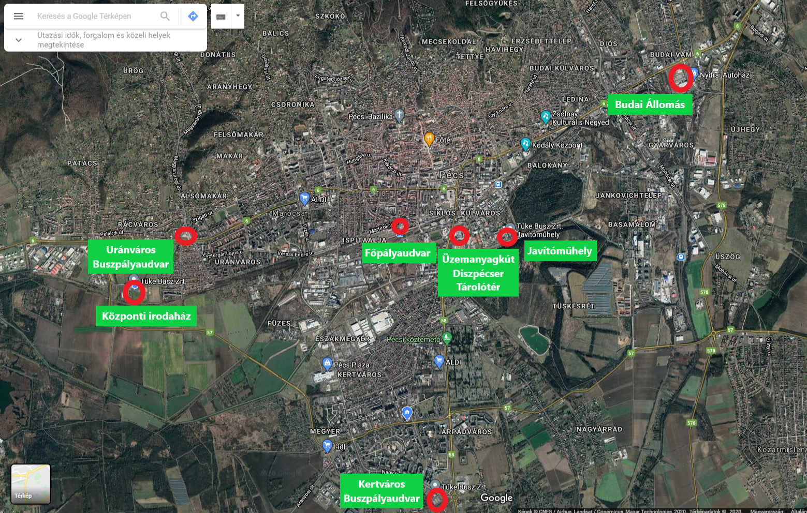
Decentralised charging
In compliance with the location of the city (morphology)
In support of maximising mileage
Energy need of hilly sections
Securing the operation
Maximising rolling stock roster
Meeting special needs

Slide 13
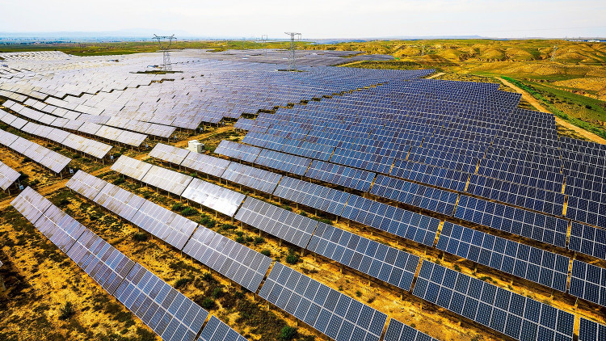
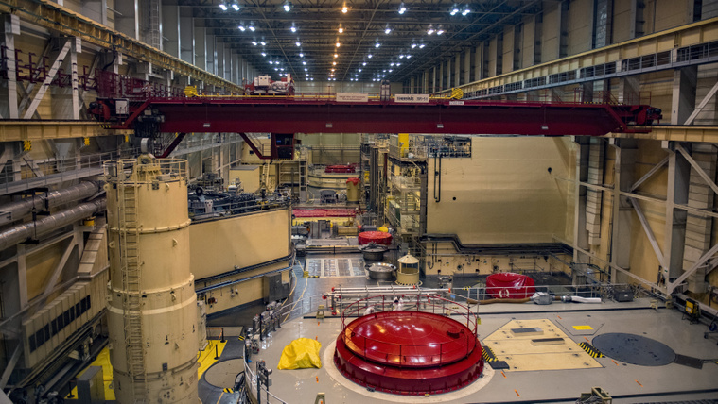
Problems on horizon
From where we receive/purchase the necessary amount of energy?
How to charge with photovoltaics during the night?
What happens if one time 174 buses are connected to chargers?

Slide 14
Opportunities for implementation
Deployment of PVs, creating a local power station which feed into the city grid that energy during the day which is used by electric buses for charging during the night
Decentralised charging, with smart management of charging
Low cost of investment
Provision of optimal use of energy
Implementation that result in secure operation
Storage? €€€+

Slide 15
Questions of the future
What would happen if the whole fleet is replaced by electric buses?
How to manage charging?
What is the solutions to runaway energy prices?
Hydrogen buses?

Slide 16
Possible answers
Solution to be sought to the altered, unprecedented energy needs
Establishment of grid system in charging and in operation starting with e-bus charging, ending at passing the buses to drivers, system level automation is needed for optimal operation
Operation of homogenous fleet
Using as much as possible renewable enery during operation
Use of hydrogen driven buses, maximal support provided to green hydrogen projects

Slide 17
Thank you for your attention!

